Slide 1
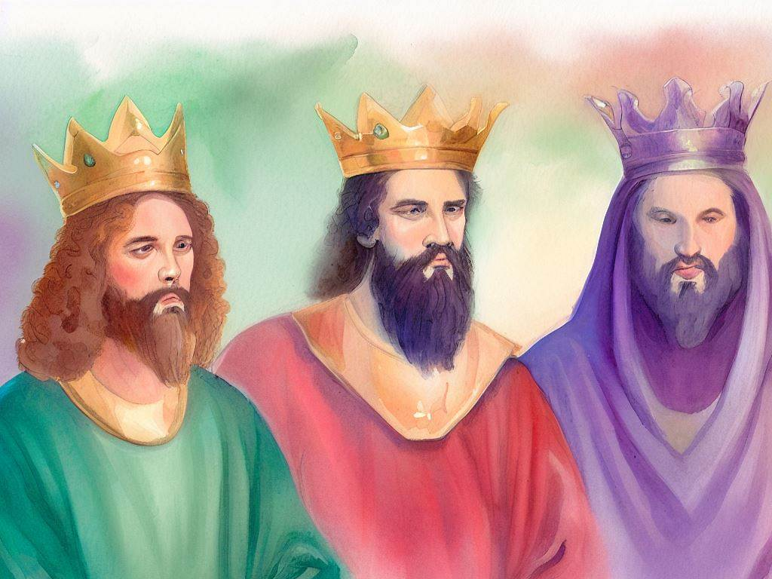
United Kingdom
Quarter 4: Lesson 7 Jonathan and David (1 Samuel 20-21)

Slide 2
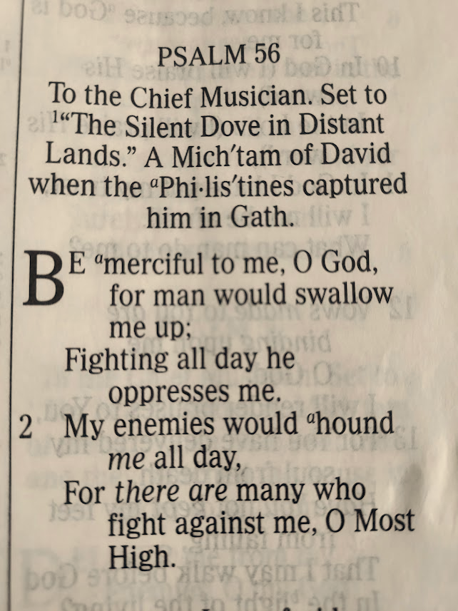
Jonathan’s Love for David & Saul’s Hatred for David
Jonathan’s loyalty to David (1 Sam. 20)
David and the Holy Bread (1 Sam. 21:1-9)
David flees to Gath (1 Sam. 21:10-15)
Psalms 34 & 56

Slide 3
Jonathan’s Loyalty to David (1 Samuel 20)
David flees Naioth in Ramah and goes to Jonathan (20:1-3)
David asks, What sin have I done that your father seeks my life?
Jonathan asserts that Saul would not seek to kill David without informing Jonathan.
David is certain that Saul is hiding his intentions from Jonathan to spare Jonathan’s feelings.
He assures Jonathan by oath that “There is but a step between me and death.”

Slide 4
Jonathan Warns David (1 Samuel 20)
Jonathan and David agree to ascertain Saul’s true intentions by Saul’s reaction to David’s absence at the feast of the New Moon (20:4-7).
David asks Jonathan to deal kindly with him based on their covenant before the Lord (20:8-10).
If David is worthy of death, Jonathan should just go ahead and kill him now.
But Jonathan assures David that he will inform him of Saul’s intentions.
David asks, “Who will tell me if your father answers you roughly?”
Notes:
New Moon feast – see Numbers 10:10 and 28:11-15
Ps 81:3 Blow the trumpet at the time of the New Moon, At the full moon, on our solemn feast day.

Slide 5
Jonathan Warns David (1 Samuel 20)
With God as witness, Jonathan and David make a covenant in the field (20:11-17).
Jonathan promises to inform David Saul’s intentions.
In return, David would not cut off his kindness from Jonathan and his household forever.
Jonathan loved David, so he made this covenant with “the house of David” and caused David to vow it.
They make a plan for warning David (20:18-23).
David will be missed at the New Moon feast.
David is to stay away until the third day, then return to where he had hidden before by the stone Ezel.
Jonathan will shoot three arrows to the side, and David will know if he is safe based on the instructions Jonathan gives a lad for finding the arrows.
Notes:
New Moon feast – see Numbers 10:10 and 28:11-15
Ps 81:3 Blow the trumpet at the time of the New Moon, At the full moon, on our solemn feast day.

Slide 6
Jonathan Warns David (1 Samuel 20)
Saul discloses his intentions (20:24-34).
On the first day of the feast, Saul assumes David is absent due to uncleanness. On the second day, He inquires why David is absent.
Jonathan uses the made-up excuse that David has gone to be with his brothers in Bethlehem.
Saul’s anger is aroused against Jonathan.
Saul calls Jonathan the son of a vile woman.
Saul says that as long as David “lives on the earth, you shall not be established, nor your kingdom. Now therefore, send and bring him to me, for he shall surely die."
Jonathan asks what had David done.
Saul hurls his spear at his own son!
Jonathan leaves, angry, upset, and grieved for David.
Notes:
"You son of a perverse and rebellious woman" (1 Samuel 20:30) This vile slur cast
upon Jonathan was the ancient equivalent of the vulgar present-day insult

Slide 7
Jonathan Warns David (1 Samuel 20)
Jonathan and David meet and grieve (20:35-42).
In the morning, Jonathan returns with a lad whom he instructs to find the arrows he shoots.
Per their prearranged signal, Jonathan lets David know that all is not well. Saul wants him dead.
Jonathan sends the lad back to the city with his weapons.
Jonathan and David meet, kiss, and weep together, with David weeping the most.
Jonathan says, "Go in peace, since we have both sworn in the name of the LORD, saying, 'May the LORD be between you and me, and between your descendants and my descendants, forever.”

Slide 8
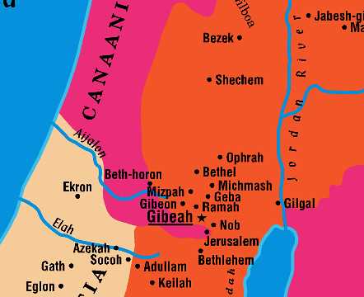
Geography of 1 Samuel 21

Slide 9
David and the Holy Bread (1 Sam 21:1-9)
David flees to Nob, to Ahimelech the priest (21:1-7).
Ahimelech greets David warily because he is alone.
David says that Saul has sent him on a secret mission, and that he has sent his men elsewhere.
David asks for loaves of bread.
Only Holy bread is available, but the priest will give it to David if his young men are not unclean.
David assures Ahimelech that his men are clean and rationalizes that the bread was in effect common (even though had just been replaced that day).
Ahimelech gives David the bread.
Doeg, an Edomite ally of Saul, witnesses this (21:7).
When David asks for a sword, and Ahimelech gives him the sword of Goliath which was stored there (21:8-9).
Notes:
Leviticus 24:5-9 “You shall take fine flour and bake twelve loaves from it; two tenths of an ephah shall be in each loaf. 6 And you shall set them in two piles, six in a pile, on the table of pure gold before the LORD. 7 And you shall put pure frankincense on each pile, that it may go with the bread as a memorial portion as a food offering to the LORD. 8 Every Sabbath day Aaron shall arrange it before the LORD regularly; it is from the people of Israel as a covenant forever. 9 And it shall be for Aaron and his sons, and they shall eat it in a holy place, since it is for him a most holy portion out of the LORD's food offerings, a perpetual due.”
1Sa 22:10 "And he inquired of the LORD for him, gave him provisions, and gave him the sword of Goliath the Philistine.“

Slide 10
David and the Holy Bread (1 Sam 21:1-9)
David flees to Gath (21:10-15).
David flees from Saul to Achish, king of Gath.
The servants of Achish recognize David and inform Achish that this is the Israelite lauded for killing “ten thousands.”
David is very much afraid, so he pretends to be crazy by scratching on the doors and drooling.
Achish says he has no need of a crazy person; he refuses to allow David to stay.
“Do I lack madmen, that you have brought this fellow to behave as a madman in my presence? Shall this fellow come into my house?”

Slide 11
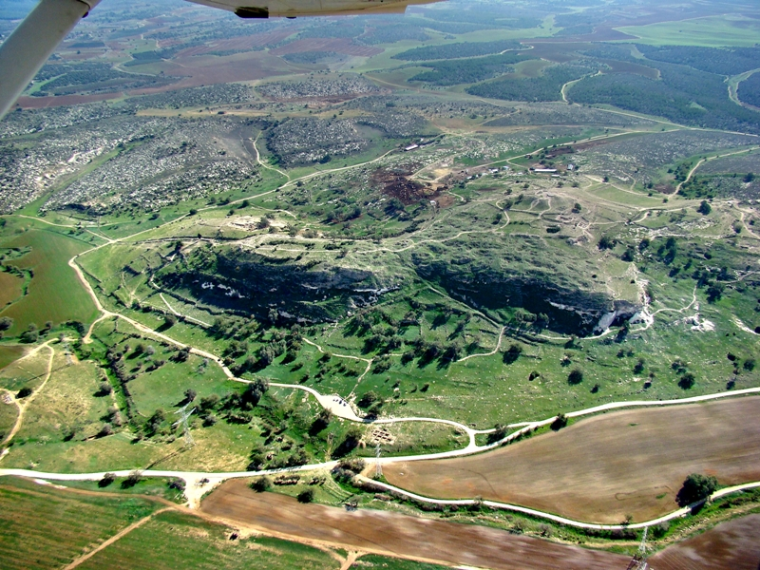
Aerial view of Gath Photo by Leon Mauldin

Slide 12
Psalm 56: Trust in God when surrounded by Enemies (A Psalm of David)
To the Chief Musician. Set to "The Silent Dove in Distant Lands." a Michtam of David When the Philistines Captured Him in Gath.
Psalm 56:3-4 Whenever I am afraid, I will trust in You. In God (I will praise His word), In God I have put my trust; I will not fear. What can flesh do to me?
Psalm 56:8 You number my wanderings; Put my tears into Your bottle; Are they not in Your book?
Psalm 56:11 In God I have put my trust; I will not be afraid. What can man do to me?

Slide 13
Psalm 34: Taste and See that the Lord is Good (A Psalm of David)
A Psalm of David When He Pretended Madness Before Abimelech, Who Drove Him Away, and He Departed.
Psalms 34:1 I will bless the LORD at all times; His praise shall continually be in my mouth.
Psalms 34:3 Oh, magnify the LORD with me, And let us exalt His name together.
Psalms 34:7 The angel of the LORD encamps all around those who fear Him, And delivers them.
Psalms 34:19 Many are the afflictions of the righteous, But the LORD delivers him out of them all.

Slide 14
Applications for Today
Choose to support whom and what the Lord supports, whether your family does or not (Mark 3:34-35; Matthew 10:37).
Lying is sin, an abomination to the Lord. Lies or other sins are NOT JUSTIFIED just because they are committed by God’s people in the Scripture’s historical narrative (Proverbs 6:16-17; 12:22; Ephesians 4:25).
God desires mercy, not sacrifice (Matthew 12:1-8).
Notes:
Mark 3:34-35 And He looked around in a circle at those who sat about Him, and said, "Here are My mother and My brothers! 35 For whoever does the will of God is My brother and My sister and mother.“
Matthew 10:37 He who loves father or mother more than Me is not worthy of Me. And he who loves son or daughter more than Me is not worthy of Me.
Michal lied about David being in the bed sick.
Jonathan lied about David going to Bethlehem.
David lied about being on a secret mission for the king.
Proverbs 6:16-17 a lying tongue is an abomination to the Lord
Proverbs 12:22 Lying lips are an abomination to the LORD, but those who act faithfully are his delight.
Ephesians 4:25 Therefore, putting away lying
Revelation 21:8 all liars shall have their part in the lake which burns with fire and brimstone, which is the second death."
Matthew 12:1-8 At that time Jesus went through the grainfields on the Sabbath. And His disciples were hungry, and began to pluck heads of grain and to eat. 2 And when the Pharisees saw it, they said to Him, "Look, Your disciples are doing what is not lawful to do on the Sabbath!" 3 But He said to them, "Have you not read what David did when he was hungry, he and those who were with him: 4 how he entered the house of God and ate the showbread which was not lawful for him to eat, nor for those who were with him, but only for the priests? 5 Or have you not read in the law that on the Sabbath the priests in the temple profane the Sabbath, and are blameless? 6 Yet I say to you that in this place there is One greater than the temple. 7 But if you had known what this means, 'I DESIRE MERCY AND NOT SACRIFICE,' you would not have condemned the guiltless. 8 For the Son of Man is Lord even of the Sabbath."

